Slide 1
Results PET MR Age

Slide 2
CN

Slide 3
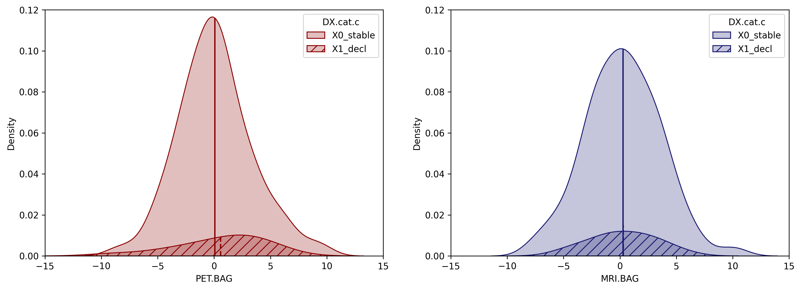
Mean PET BAG stables: [0.07794588], mean PET BAG decliners: [0.57635034].
Mean MRI BAG stables: [0.27079871], mean MRI BAG decliners: [0.28547579].
0.540144 0.463483
0.002156 0.963028
Category
Category
Stable
Decline
Stable
Decline
FDG-PET BAG [years]
MRI BAG [years]

Slide 4
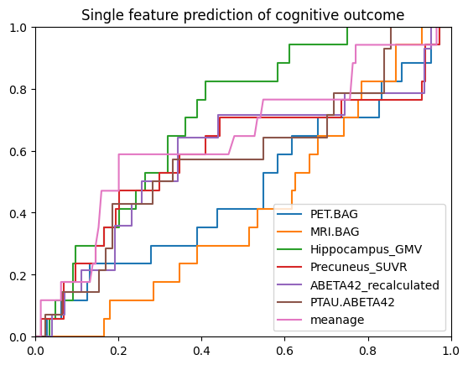
HGMV AUC 0.709
Age AUC 0.665
PET.BAG 0.551
MRI.BAG 0.471

Slide 5
SCD

Slide 6
ADNI-MEM Pearson
coeff = -0.188 , p = 0.0642"
coeff = -0.221 , p = 0.0288"

Slide 7
ADNI-EF Pearson
coeff = -0.209 , p = 0.0388"
coeff = -0.057 , p = 0.5763"

Slide 8
No interaction effects.

Slide 9
PTAU/ABETA status not different
0.5731 0.4511
F(87,1) = 0.7367 p = 0.393075

Slide 10
PET AV45 Spearman (n = 98)
coeff = 0.018 , p = 0.8584
Moderation of amyloid on interaction
PET.BAG - ABETA42_recalculated: 0.0583890322486342
AT+: coeff = 0.438 , p = 0.0535“ (n = 15)
AT-: coeff = -0.021 , p = 0.871 (n = 58)
coeff = 0.112 , p = 0.2774"

Slide 11
CSF ABETA Spearman n = 84
coeff = -0.186 , p = 0.0815"
coeff = -0.172 , p = 0.1079

Slide 12
CSF t-tau spearman n = 84
coeff = -0.232 , p = 0.0285"
coeff = -0.161 , p = 0.1318

Slide 13
CSF p-tau spearman n = 84
coeff = -0.176 , p = 0.0996"
coeff = -0.257 , p = 0.0151"

Slide 14
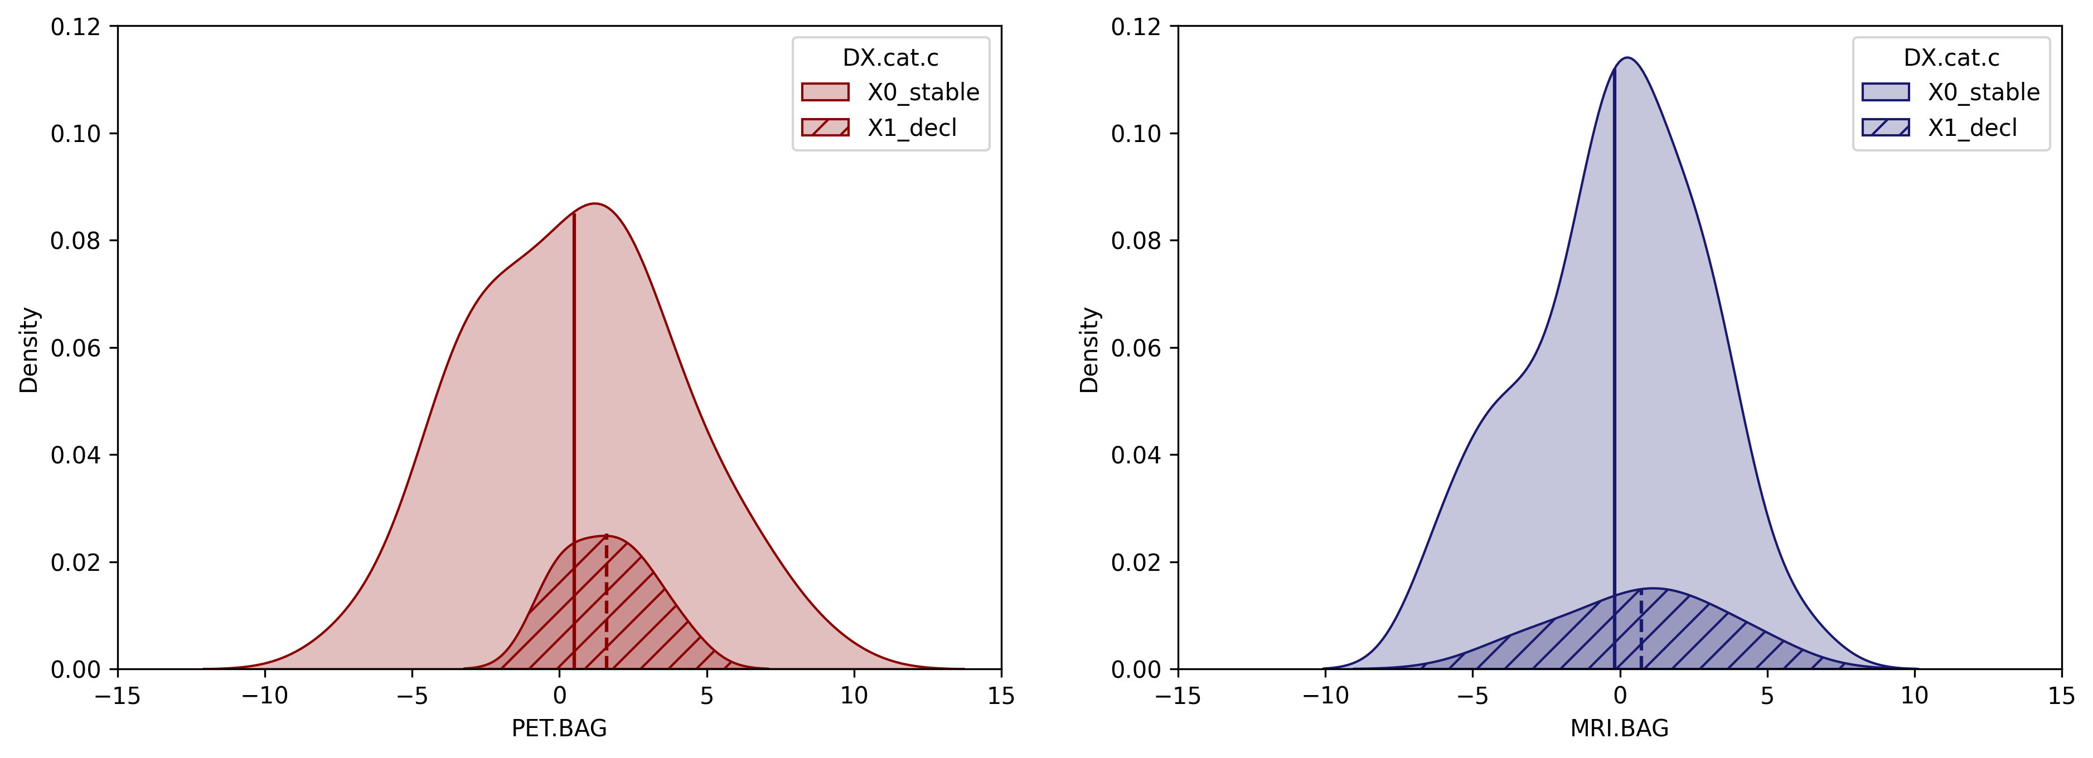
Mean PET BAG stables: [0.50717513], mean PET BAG decliners: [1.60438448].
Mean MRI BAG stables: [-0.18032244], mean MRI BAG decliners: [0.72815609].
1.416332 0.237664
0.271483 0.603834
Category
Category
Stable
Decline
Stable
Decline
FDG-PET BAG [years]
MRI BAG [years]

Slide 15
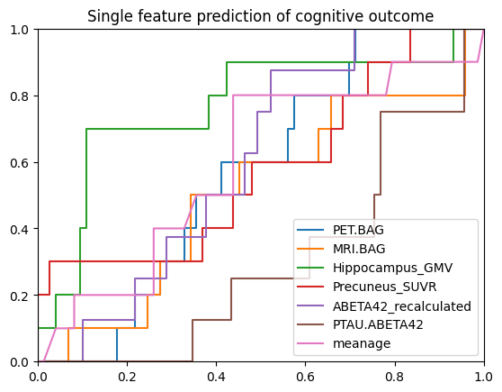
PET: AUC 0.59
MRI: AUC 0.54
HGMV: AUC 0.803
Notes:
THRESHOLD HIPPO GMV?

Slide 16
MCI

Slide 17
PTAU/ABETA status not different
ANCOVA F(462, 1) = 11.4517, p= 0.0007751 ANCOVA F(462, 1) = 15.5113 p = 9.467e-05

Slide 18
ADNI-MEM n=587 spearman
coeff = -0.368 , p = 0
Moderation of amyloid/ptau on interaction
MRI.BAG - ADNI_MEM: 0.0544170190616781
coeff = -0.206 , p = 0"

Slide 19
ADNI-MEM moderation
A/T+: coeff = -0.239 , p = 1e-04
A/T-: coeff = -0.164 , p = 0.0176

Slide 20
ADNI-EF
coeff = -0.248 , p = 0
coeff = -0.25 , p = 0"

Slide 21
PET AV45 sp n = 411
coeff = 0.154 , p = 0.0018
Moderation of amyloid on interaction
MRI.BAG - SUMMARYSUVR_WHOLECEREBNORM: 0.00404006231951806
oeff = 0.114 , p = 0.0213

Slide 22
PET AV45 Moderation sp n = 411
A/T+: coeff = 0.214 , p = 0.0027
A/T-: coeff = -0.034 , p = 0.6501

Slide 23
CSF ABETA1-42 sp n = 469
coeff = -0.141 , p = 0.0023
coeff = -0.234 , p = 0

Slide 24
T-tau sp n = 468
coeff = 0.053 , p = 0.2522
coeff = 0.071 , p = 0.1269

Slide 25
P-tau sp n = 468
coeff = 0.057 , p = 0.224
coeff = 0.081 , p = 0.0811

Slide 26
P-tau/AB sp n=468
coeff = 0.139 , p = 0.0026
coeff = 0.207 , p = 0

Slide 27
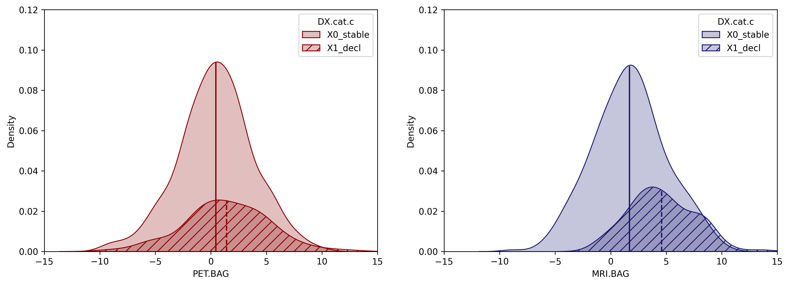
Mean PET BAG stables: [0.44088474], mean PET BAG decliners: [1.4092022].
Mean MRI BAG stables: [1.69080886], mean MRI BAG decliners: [4.58393377].
9.408502 0.002289
60.516651 4.955284e-14
p = .002
Category
Category
Stable
Decline
p < .001
Stable
Decline
FDG-PET BAG [years]
MRI BAG [years]
Notes:
R ANCOVA results pending

Slide 28
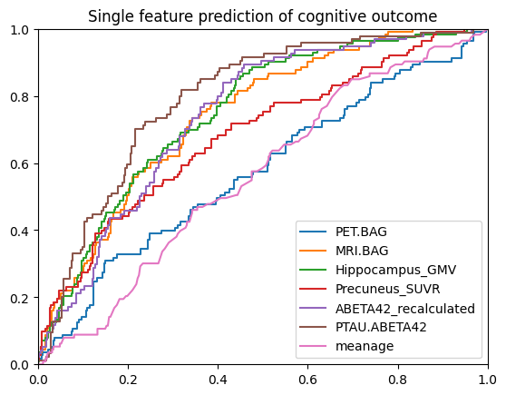
MRI BAG AUC 0.74
FDG BAG AUC 0.58
HGMV AUC 0.75
PTAU/AB AUC 0.79

